Slide 1
The Life Cycle of a Frog
Name of resource | Flashcards 3 - Sentence gap fill
Subject(s) | Science
Key Stage | Primary
Topic | Living things and their habitats

Slide 2
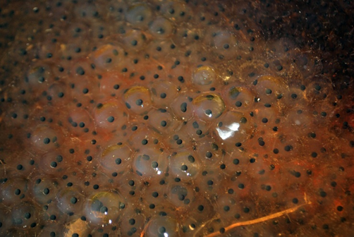

Slide 3
A ______ lays some eggs called ______ in a pond.

Slide 4
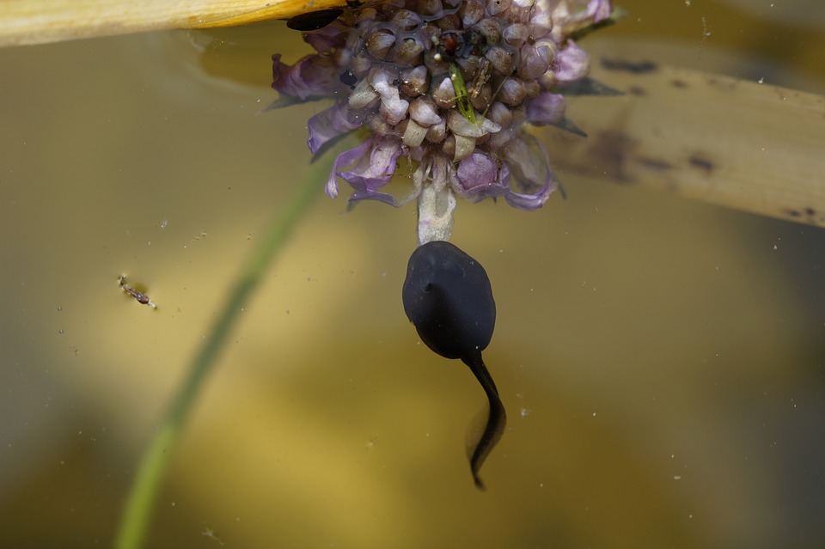

Slide 5
A ____________ hatches out of the ___________ and starts to swim around. It has a long _____ and no_________ .

Slide 6
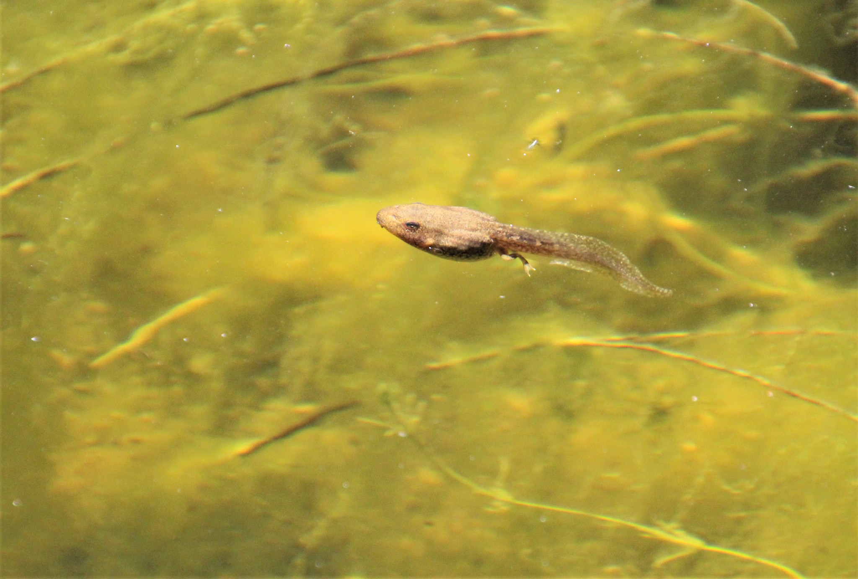

Slide 7
First the ________ grows two _______ legs.

Slide 8
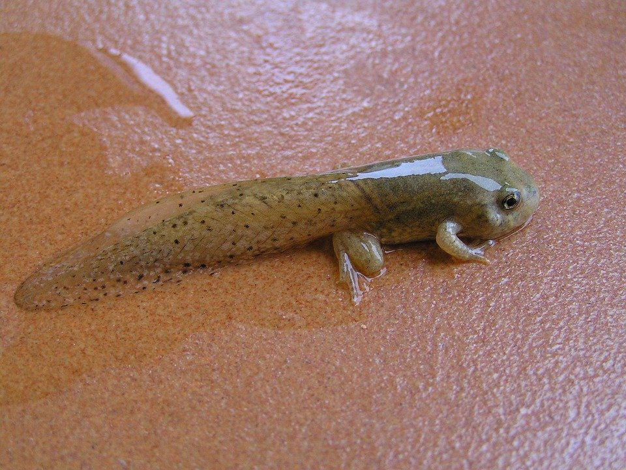

Slide 9
Then the _______ grows two _____ legs.
Now the ________ is a called a _______ .

Slide 10
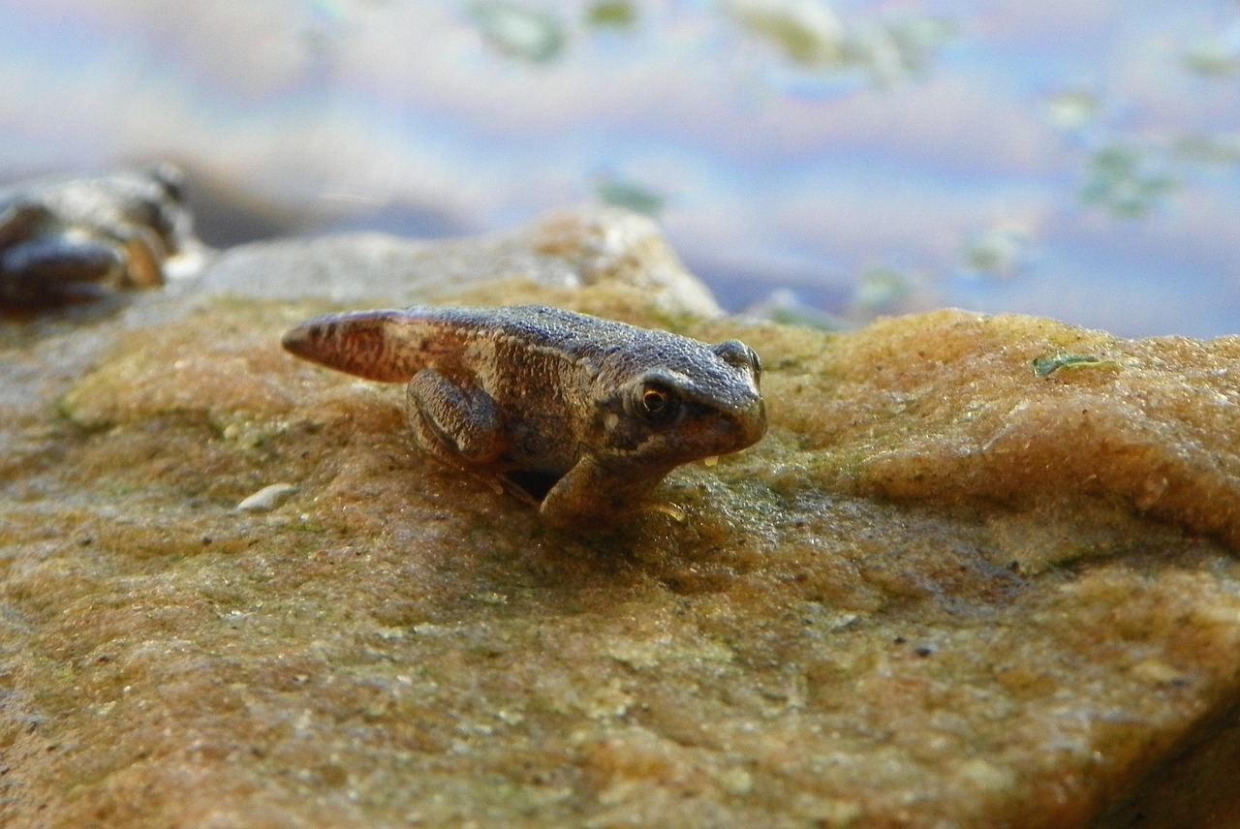

Slide 11
Finally the _______ loses its _______ .

Slide 12
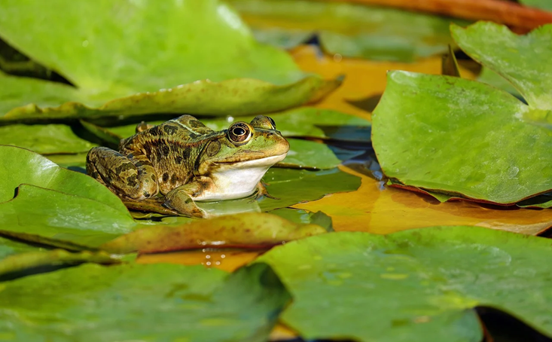

Slide 13
The ________ is now an adult ________.

Slide 14
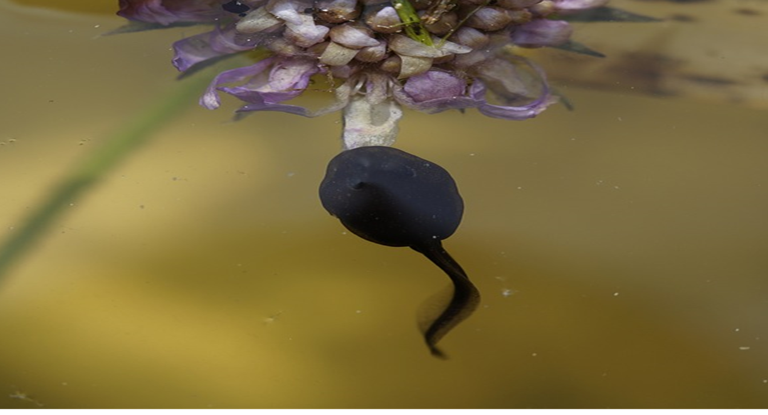
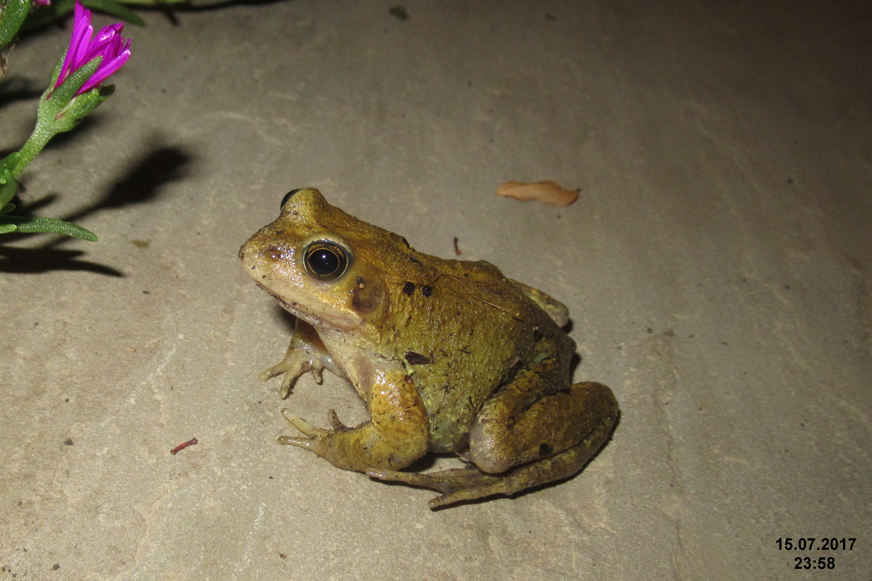

an adult frog
some frogspawn
a tadpole with no legs and a long tail
a tadpole with two back legs
a froglet with four legs
a froglet losing its long tail

Slide 15
Appendix: Images in this resource
1. Picture of some frogspawn
Frogspawn https://pixabay.com/photos/frogspawn-spawn-nature-toad-swamp-5166319/
By Mojpe https://pixabay.com/users/mojpe-885231/
Available under Pixabay License (no restrictions)
For more information see https://pixabay.com/service/license/
2. Picture of a tadpole
Tadpole https://pixabay.com/photos/tadpole-spring-frog-swim-curious-1403191/
By Efraimstocter https://pixabay.com/users/efraimstochter-12351/
Available under Pixabay License (no restrictions)
For information see https://pixabay.com/service/license/
3. Picture of a tadpole with legs
Tadpole with legs 5 https://www.flickr.com/photos/132295270@N07/48317539791
By Renee Grayson https://www.flickr.com/photos/132295270@N07/
Available under a Creative Commons Attribution 2.0 Generic (CC-BY 2.0) license. for more information see
https://creativecommons.org/licenses/by/2.0/

Slide 16
Appendix: Images in this resource
4. Picture of a froglet
Tadpole https://pixabay.com/photos/tadpole-frog-amphibious-2243033/
By aguasas https://pixabay.com/users/aguasas-5147816/
Available under Pixabay License (no restrictions)
For more information see https://pixabay.com/service/license/
5. Picture of a froglet
Froglet https://search.creativecommons.org/photos/025174ae-5a0d-4077-b6b1-6b541202df38
By HOS70 https://pixabay.com/de/users/hos70-2319664/
Available under Pixabay License (no restrictions)
For more information see https://pixabay.com/service/license/
6. Picture of an adult frog
Frog https://pixabay.com/photos/frog-water-frog-lily-pads-amphibian-2211972/
By Couleur https://pixabay.com/users/couleur-1195798/
Available under Pixabay License (no restrictions)
For more information see https://pixabay.com/service/license/

