Slide 1
Presenter:
Judit Kormos
Inclusive practices for
learning differences

Slide 2
Part 1 in this series, ‘Identifying learning differences,’ can be found at this link: https://www.youtube.com/watch?v=85b-e2wlmvc&feature=youtu.be

Slide 3

Inclusive practices for learning differences
Professor Judit Kormos

Slide 4

What is inclusive education?
Integration: it is the individual’s task to accommodate to the characteristics and demands of the institution
Inclusion: it is the institution’s responsibility to adapt to the students’ needs

Slide 5



Key principles
Recognize and
Universal design and
Learning strategies and
understand
adjustments
teaching techniques

Slide 6

Key principles
Recognize and understand

Slide 7
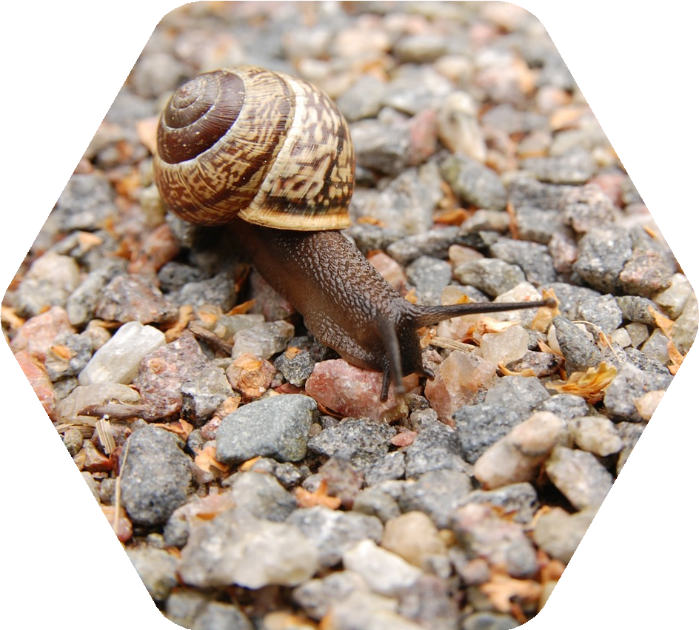


Cognitive causes of SpLDs
Short-term memory
Speed of processing
Phonological processing problems
Executive functions (attention)
SpLDs

Slide 8
Impact on second language learning
Writing
Spelling
Remembering information through listening
Accuracy and cohesion in speaking
Reading
Difficulties
Vocabulary

Slide 9









Affective aspects of SpLDs
Low self- esteem and self- confidence
Loss of motivation
Empathy (ASD)
Anxiety
SpLDs

Slide 10
Social aspects of SpLDs
Perspective taking
Collaboration and co- operation
Social communication
Following rules and norms
SpLDs

Slide 11

Strengths related to SpLDs
Holistic thinking
Peripheral vision
Creativity
SpLDs
Problem- solving
Originality
Spatial knowledge

Slide 12
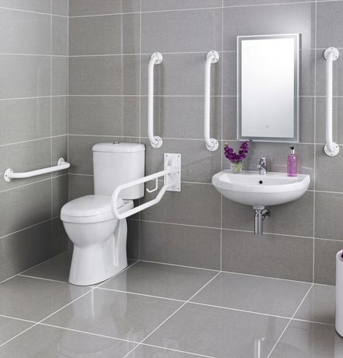
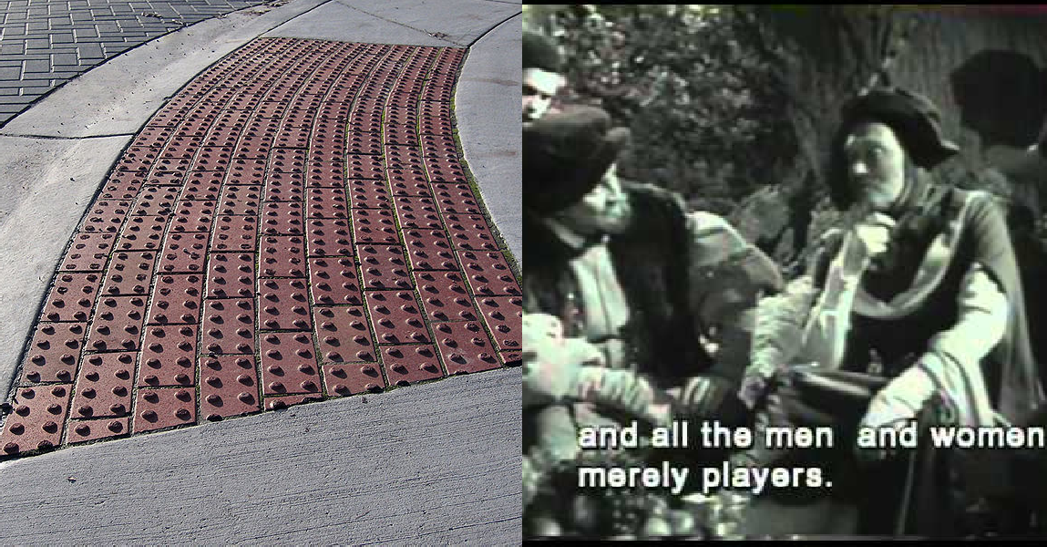
Universal design

Slide 13
Universal design: Overview of main principles
 |  | We should give learners different opportunities and choices for how they access information; for example, by how they perceive the information (visually, as in reading, or aurally, as in listening).
 |  | Multiple means of action and expression should be offered when students practise what they learned or demonstrate their knowledge in tests. These different means for expression can involve physical action, or choices between writing and speaking.
 |  | We should use different ways of engaging students, arousing their interest, maintaining their motivation and helping them with regulating their own learning, i.e. with appropriate learning strategies.

Slide 14
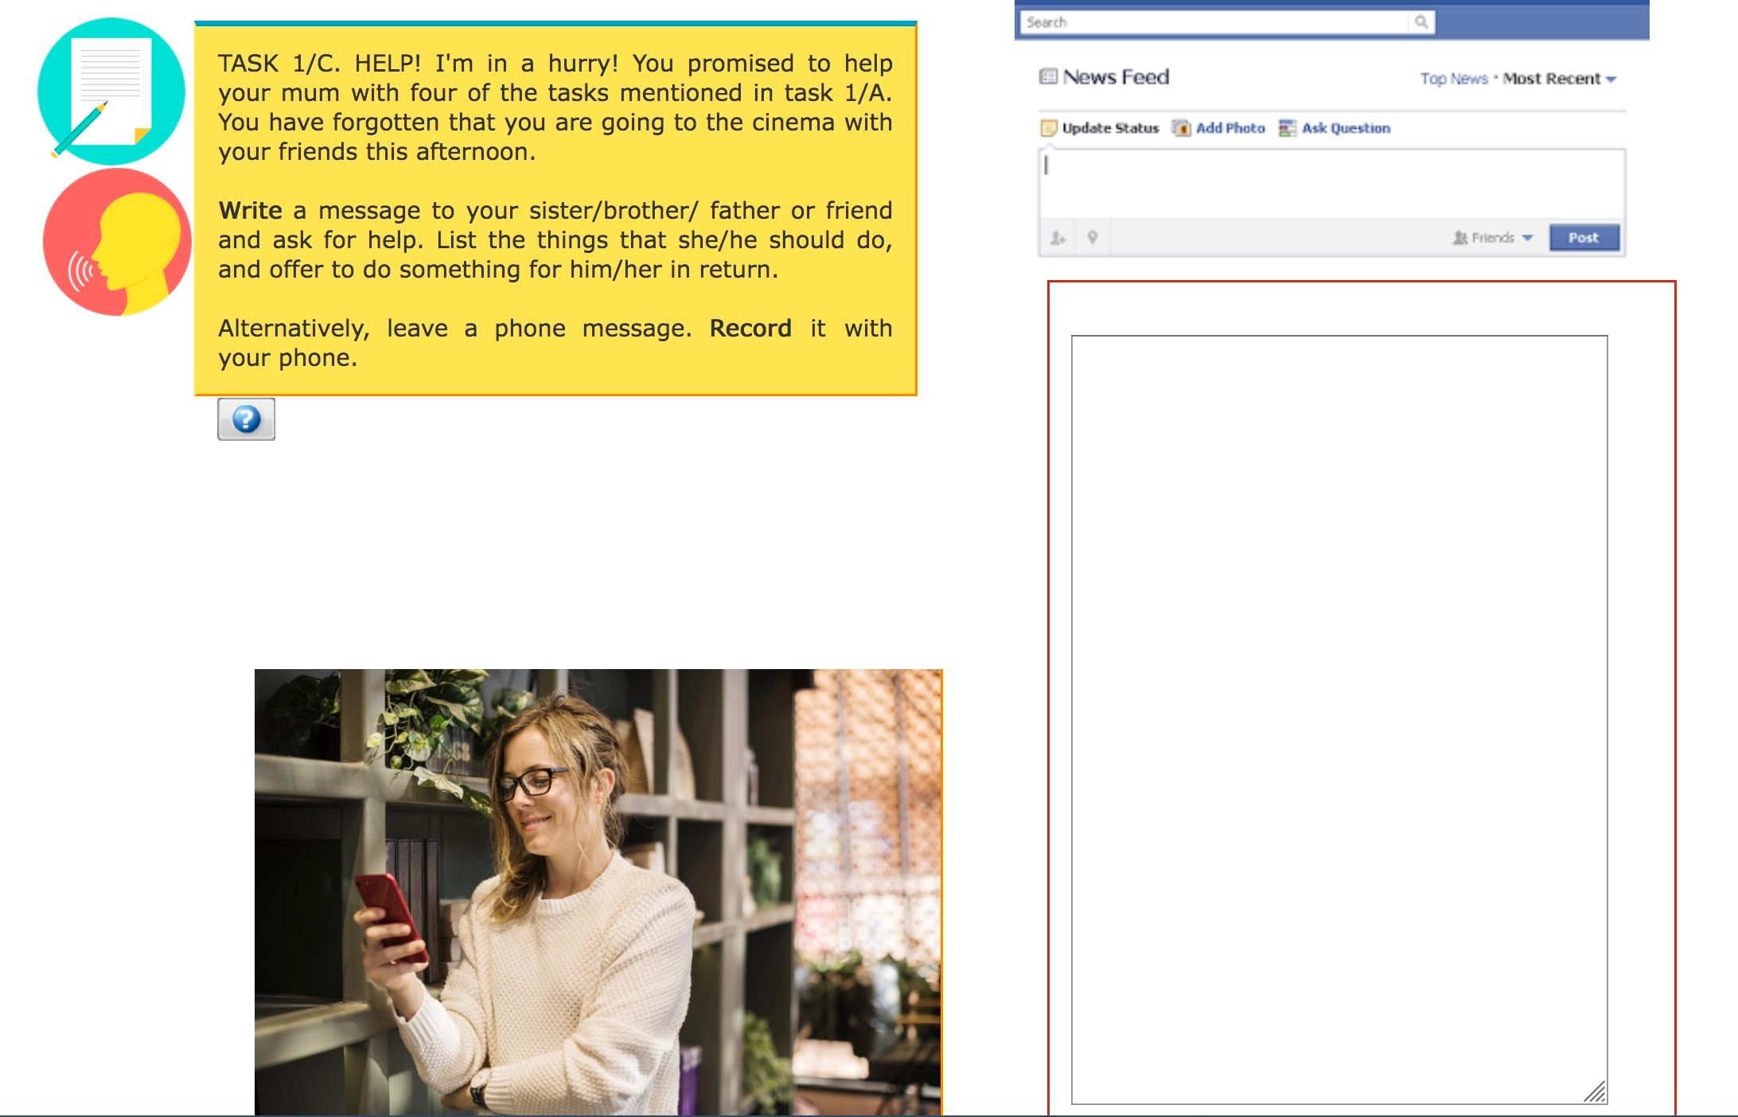

Options for expression

Slide 15
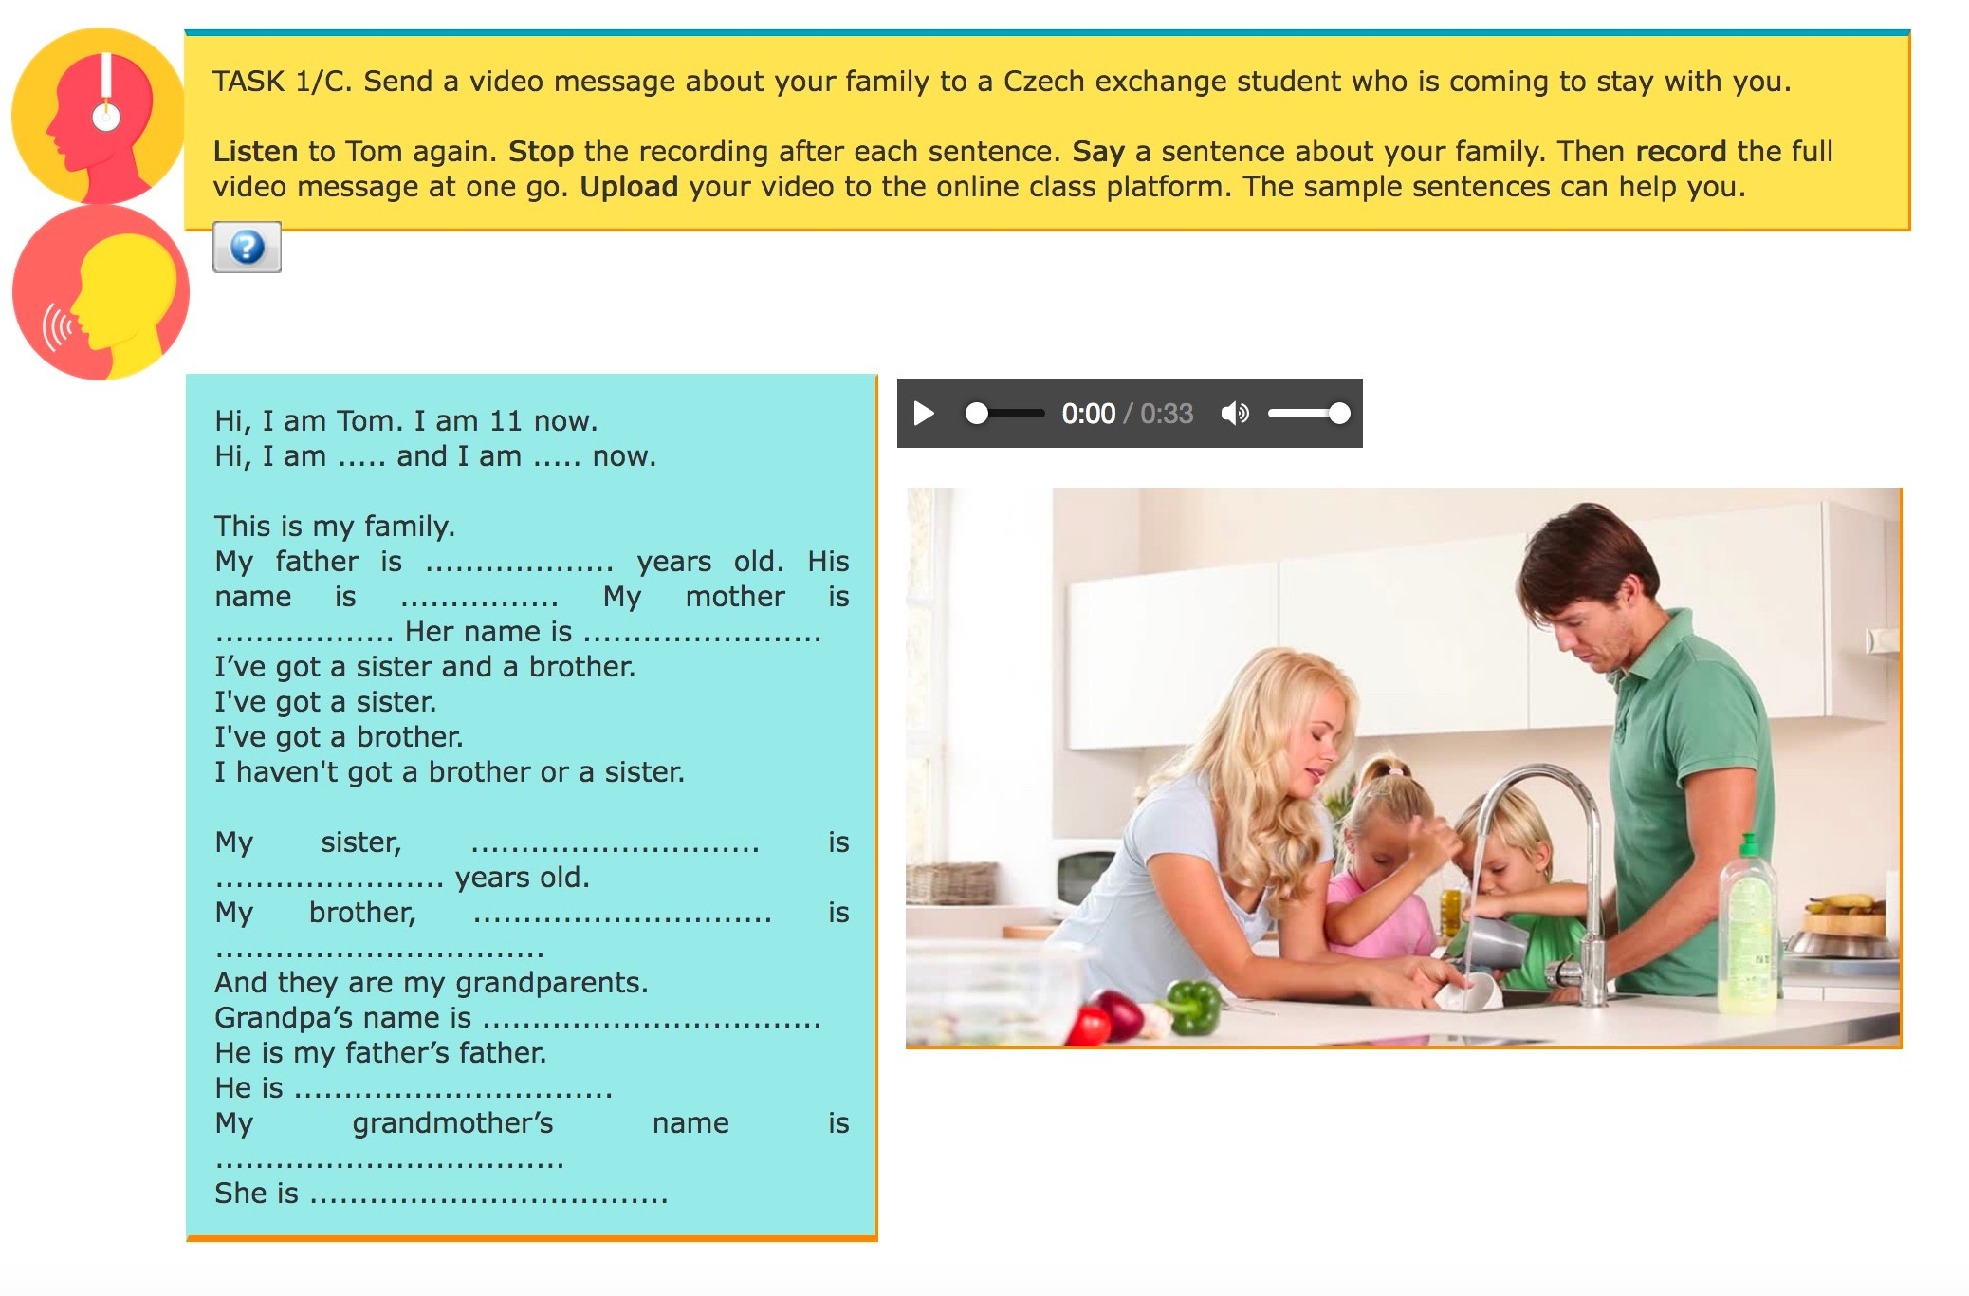
Graduated levels of support

Slide 16
Advantages of online learning for students with SpLDs
More flexibility with timing and tasks
More assistive tools available More project-based learning
Fewer timed tests - alternative assessment formats Fewer demands on complex social interaction skills

Slide 17
Disadvantages of online learning for students with SpLDs
Less structured learning environment
Lower level of teacher control
Higher level of autonomy and self-regulation required Potentially long screen time
Fewer social clues on screen

Slide 18
Explain clearly in a step-by-step manner how various online platforms work.
Supporting students with SpLDs in online learning
Give time to adjust.
Dedicate special tasks, online forums, and hold online discussions on how to learn at home.
Teach the use of assistive devices (speech to text, text to speech, day planners etc)
One-to-one meetings or small group meetings with students with SpLDs.
Peer mentors

Slide 19




Break down tasks into smaller steps
Bite-size online learning
Stagger instructions
Adjust tasks to attention span (Pomodoro technique; https://plantie.app/)
Include periods of physical activity in the online session

Slide 20





Use multiple modes of presentation (auditory, written, video, pictures etc)
Allow students alternative response formats
Accessibility of online learning
Make sure instructions are short, concise and clear.
Use file format which is easy to convert into accessible mode.
Give students choices and options in tasks and how they want to complete them

Slide 21
Harness
Harness students’ strengths with project- based, multi-media tasks and portfolio- based assessments
Other tips for supporting online learning for students with SpLDs
Vary
Vary plenary work with breakout rooms or some off-line work in synchronous sessions
Use
Use interactive tools during synchronous sessions (Kahoot, Mentimeter, Polls, Padlet wall, Online quizzes etc).

Slide 22

What can we adjust in our classes?
Accommodations

Slide 23
What can we adjust?
Presentation and access to material
(multiple channels, handouts)
Classroom management (groupwork, pairwork)
Accommodations
Environment (Light, temperature, seating arrangements)
Level of support (teacher, peers)
Pacing
(slow down, revise, recycle)

Slide 24

Roadmap to success
Learning strategies and teaching techniques

Slide 25




Planning the learning process
What? When? Where? How?
Learning strategies – Self-regulation of learning
Regulating attention
Pomodoro technique
Visualize success Rewarding success
Mistakes and failures are part of the learning process
Regulating feelings and motivation
Test yourself Diary, journal
Self-evaluation

Slide 26
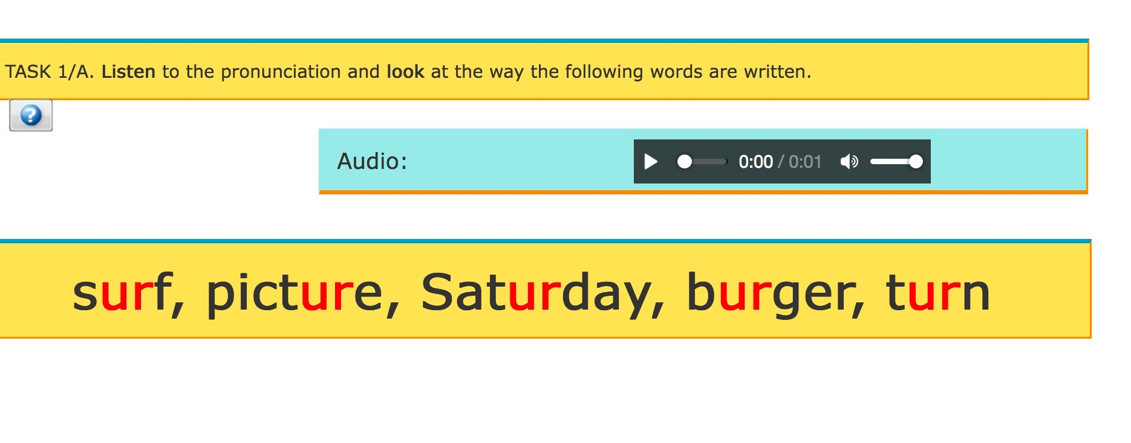

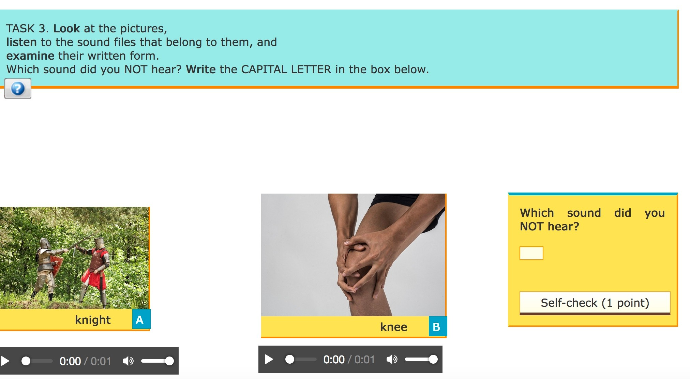
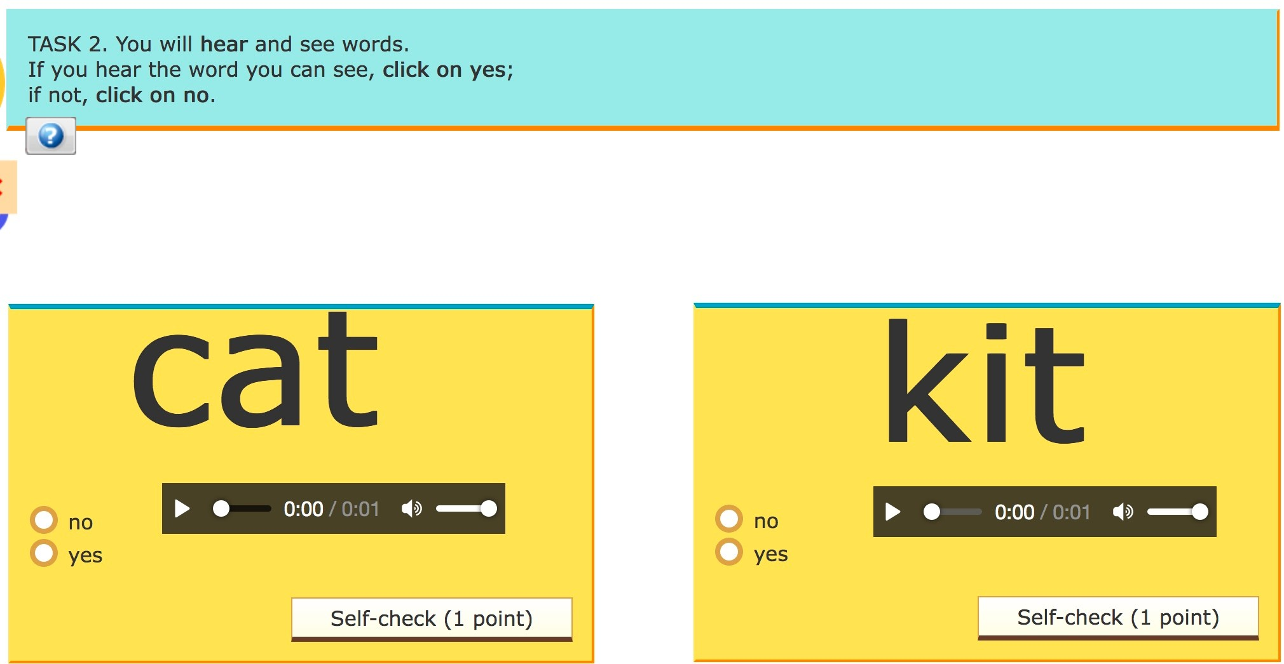
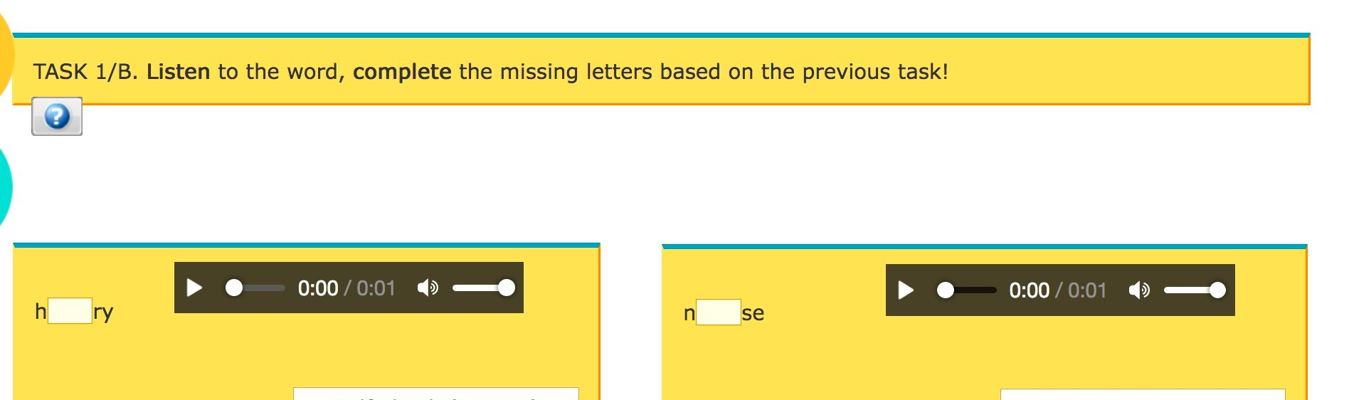
Developing underlying spelling and pronunciation skills
http://engage.uni-miskolc.hu/index.php/self-study-course/
Orthographic and phonological awareness training
Training in word recognition
Explicit teaching of spelling and pronunciation regularities

Slide 27
What strategies do you use?
Vocabulary learning strategies
How do they work?
Does the strategy depend on the type of word?
Is there anything within the words or the wordsets that make learning difficult?

Slide 28
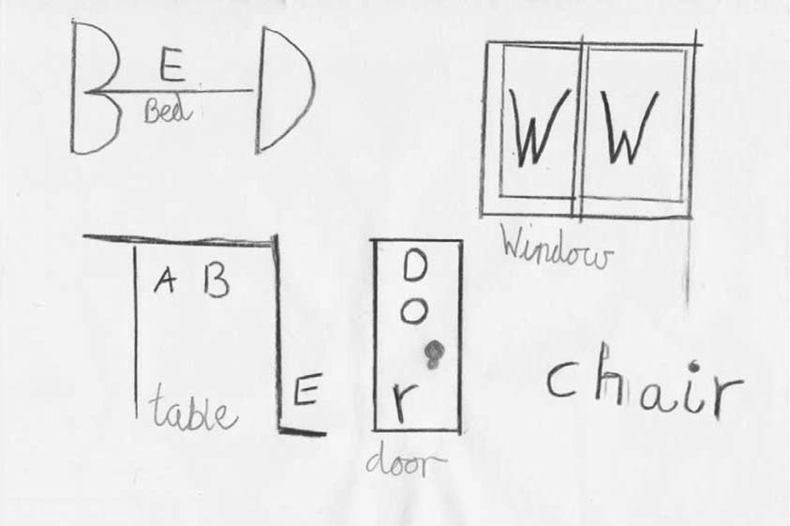
Drawing
Acting out
Computer apps: Quizlet, Anki
Mnemonics Big Elephants Can Always Understand Small Elephants Keywords
Chunking
Rhyme, songs, rhythm

Slide 29

Reading strategies
Activate background knowledge based on the title, sub-titles, headings, visuals
Use prediction and visualization Monitor comprehension, make inferences
Reread Subvocal reading
Reading while listening (text to speech software) Annotate text, highlight, notes, charts, mind- and concept maps

Slide 30
Idea
Idea
Idea
Idea
Idea
Idea
Public services
Education
Jobs
Better access for people with disabilities

Slide 31
What (question)?
Who?
Where?
Access for people with disabilities
When?
Why?
How?

Slide 32
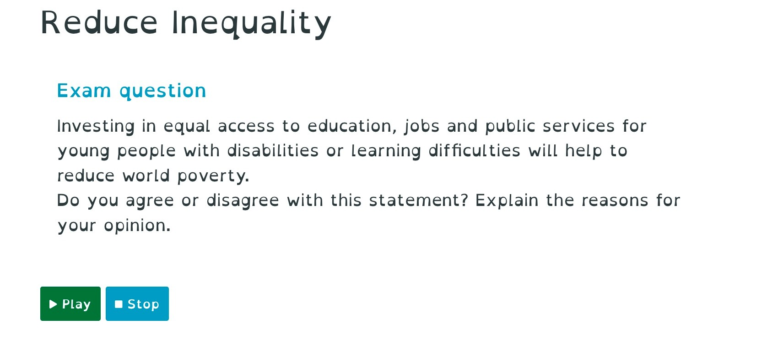
Using comics for developing reading skills
https://ciell.eu/app/

Slide 33
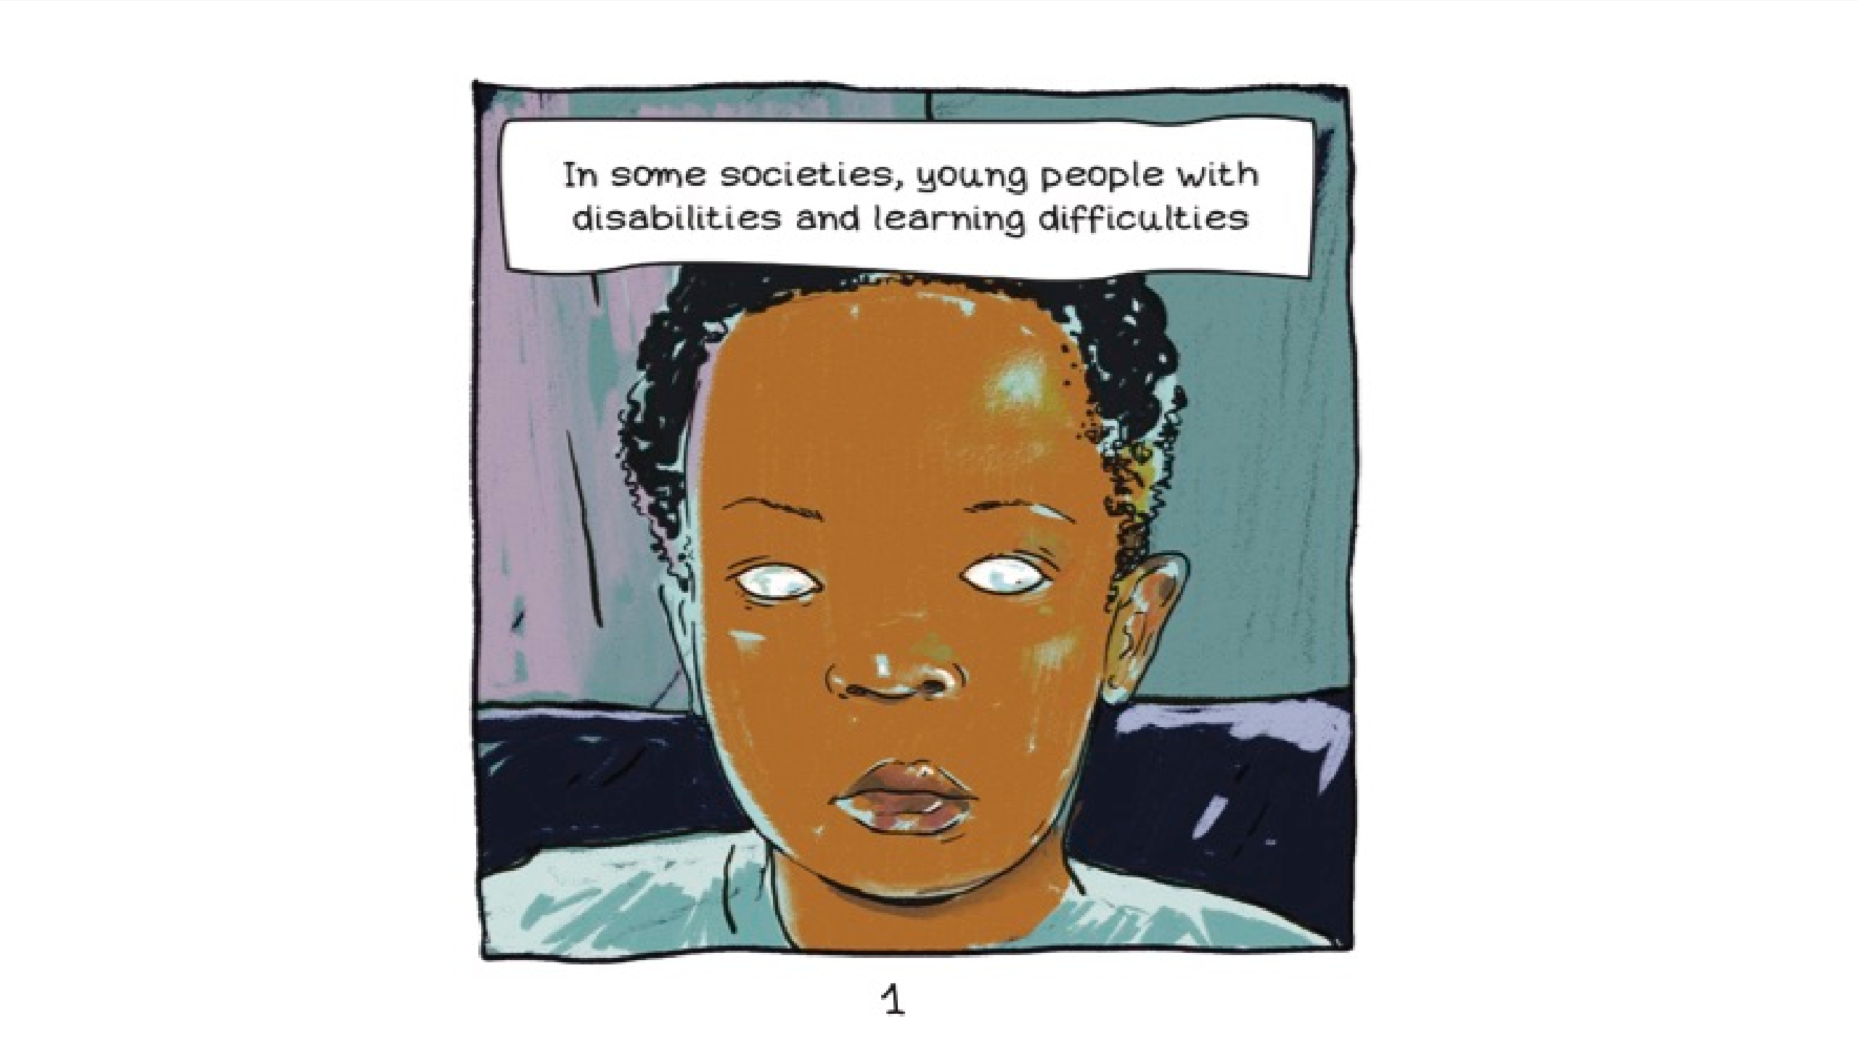

Slide 34
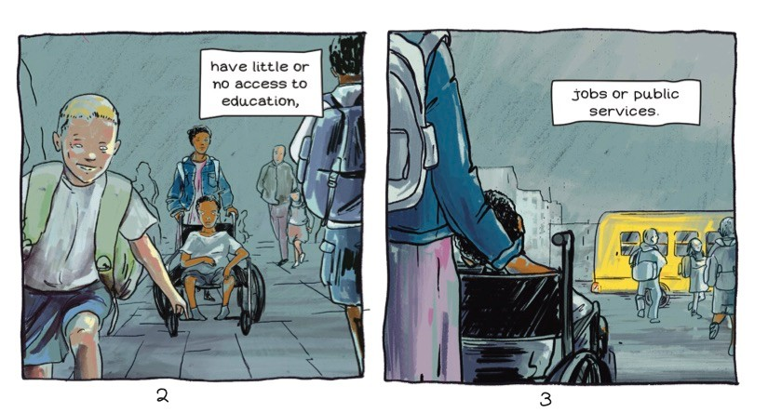

Slide 35
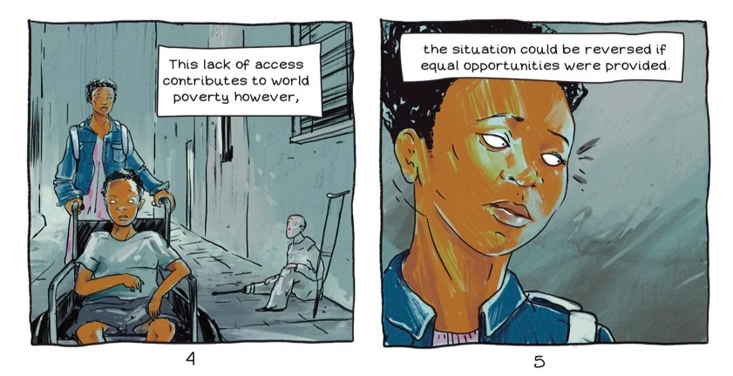

Slide 36



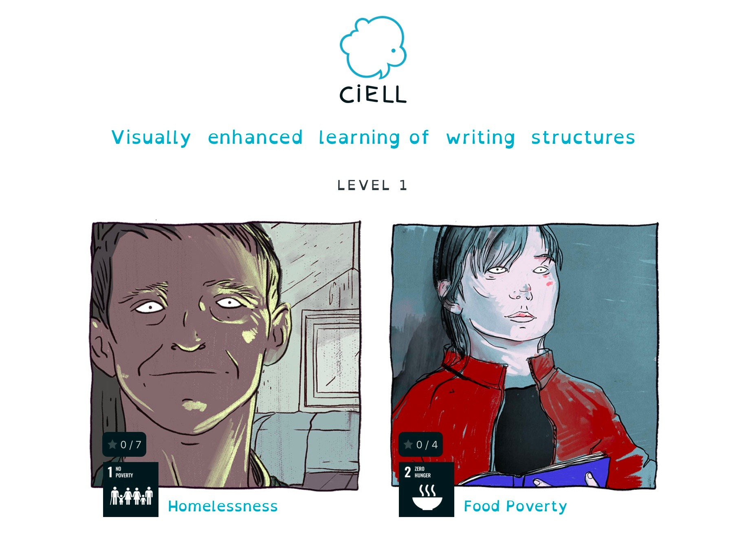


Comics as educational tools
Fun
Engaging
Motivating to read
Multi-modal
Bridge the gap between media we read and media we watch

Slide 37
Educational value of comics- Enhancing
Requires an active participation on the part of the reader
– synthesizing information between two panels
Imagination is needed to combine the visuals and text in the adjacent panels to transform them into a single idea
Enhances comprehension and helps with understanding difficult concepts
comprehension and information processing
Visuals help recall information
Fosters visual literacy

Slide 38
Reciprocal teaching
Students read the text section by section and at the end of each section:
Summarizer: highlights key ideas,
Questioner asks questions about the section (e.g. unknown words, unclear meaning etc.)
Clarifier answers questions.
Predictor makes predictions about what the next segment of the text is about.
Supporting
reading in
collaborative
group work
Directed Reading-Thinking Activity
start by making predictions about what the text segment will be about.
Read the relevant part of the text to check predictions,
Discuss to what extent their predictions were confirmed
Summarize the key information from the text segment.
Repeat in cycle after each text segment

Slide 39

Writing tips
Include planning activities such as brainstorming, creating mind-maps, outlines
Make planning multi-sensory, e.g., organise ideas by manipulation of shapes and colours
Break up the tasks into smaller sub-tasks
Give enough time for writing
Use aids for writing (e.g., spell checker, speech to text function, electronic dictionary)
Check-lists to guide learners and assist in self-evaluation
Set a specific linguistic focus in the writing task (e.g., students to pay attention to the use of past tense)
Share and make writing purposeful (e.g. Padlet)
Collaborative writing (Google docs, Etherpad, Microsoft Word online)

Slide 40




Sparks interest in writing
Educational value of comics- Enhancing writing skills
Helps organization through storytelling and storyboarding
Develops creative and higher level thought processes
Develops writing skills through multi- modal connections

Slide 41
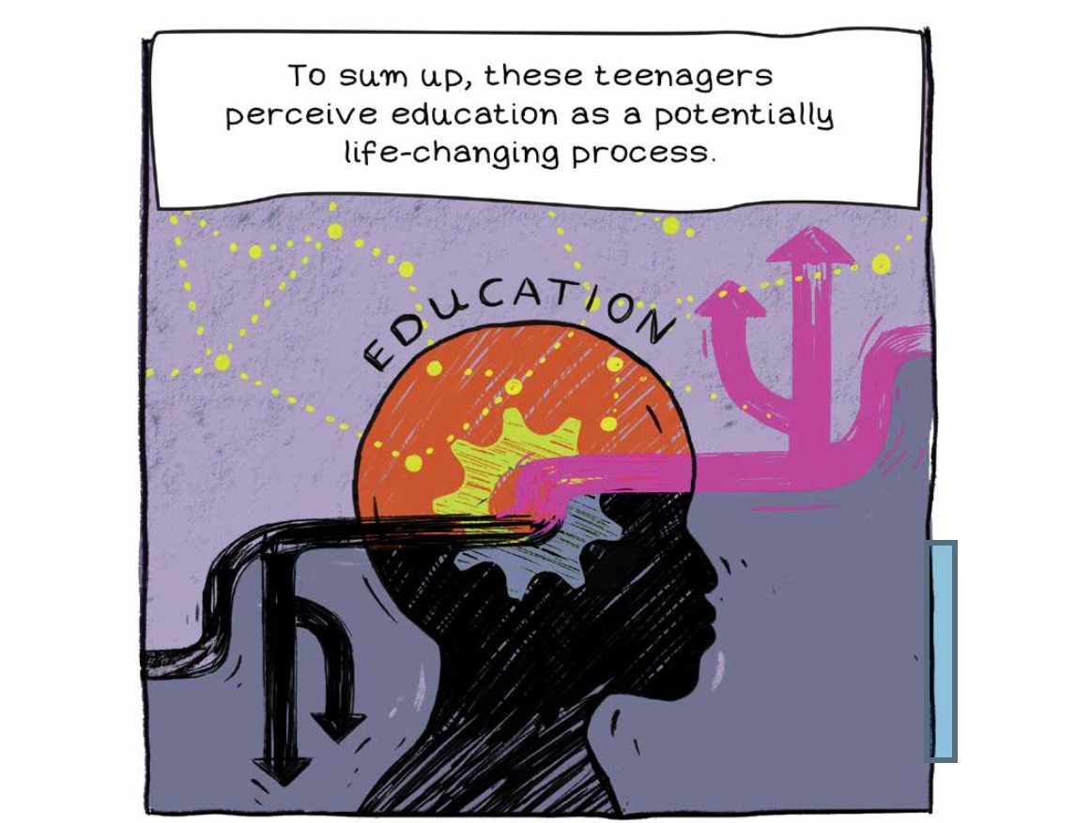
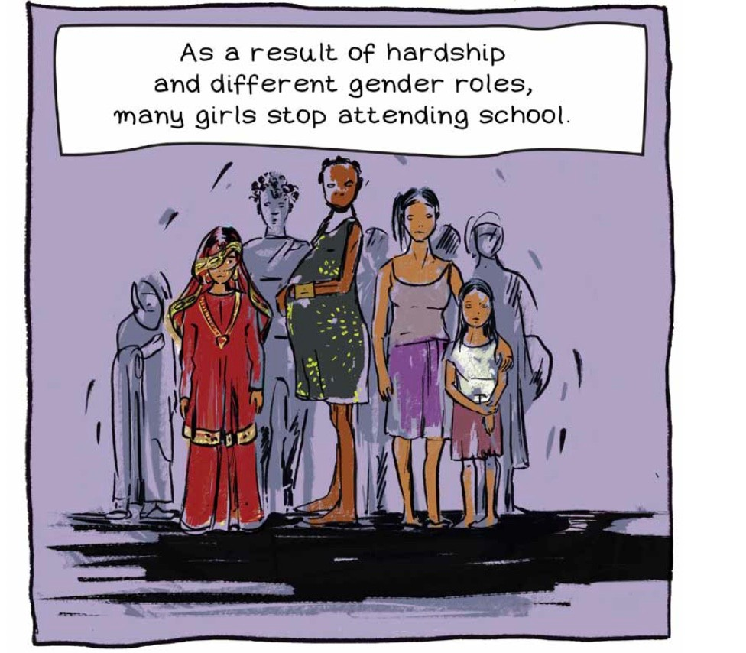
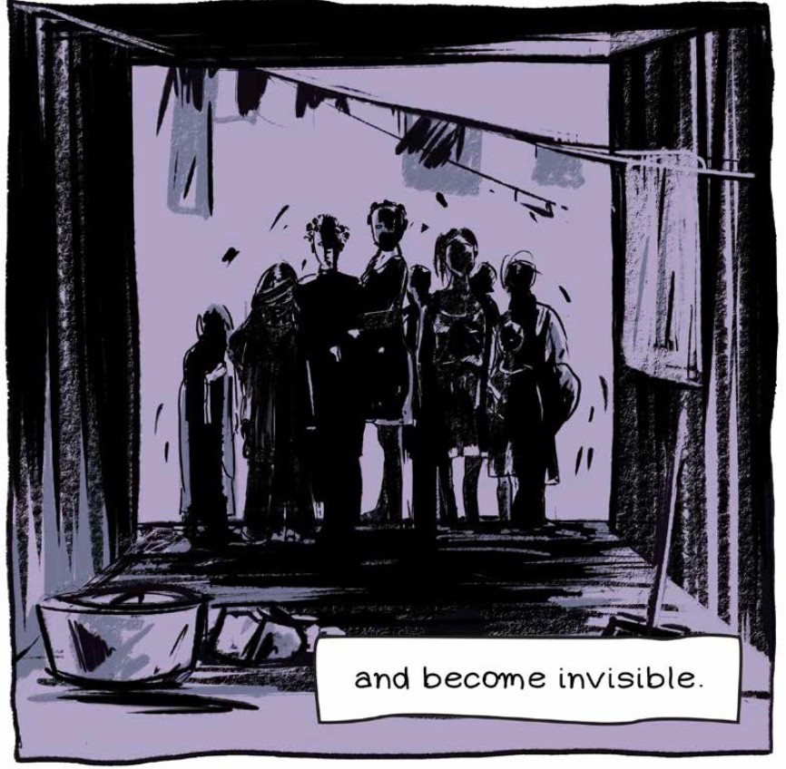
Men

Slide 42
Roadmap to success
Recognize and
Universal design
Learning strategies
understand
and adjustments

Slide 43

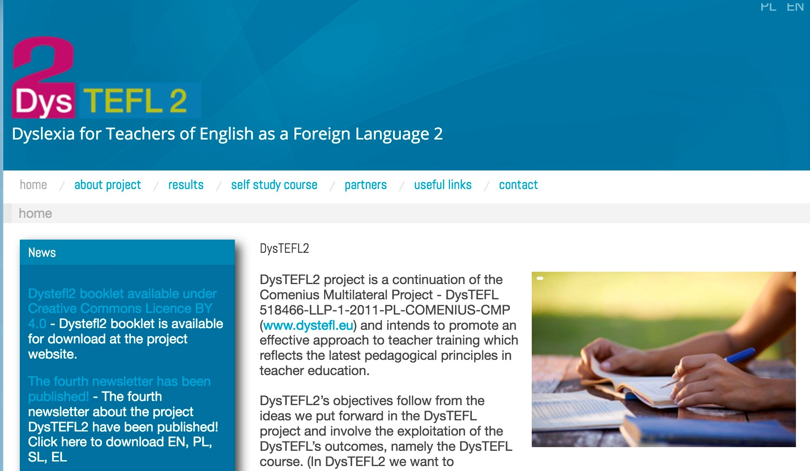





More resources
http://dystefl2.un.lodz.pl/
https://www.cambridge.org/gb/files/2415/7856/0079/CambridgePapersInELT_Sp LDs_2020_ONLINE.pdf?utm_source=wobl&utm_medium=blog&utm_content=wo blcontent&utm_campaign=insights&utm_class=download
http://engage.uni-miskolc.hu/
41

Slide 44

Questions and comments?

